Slide 1

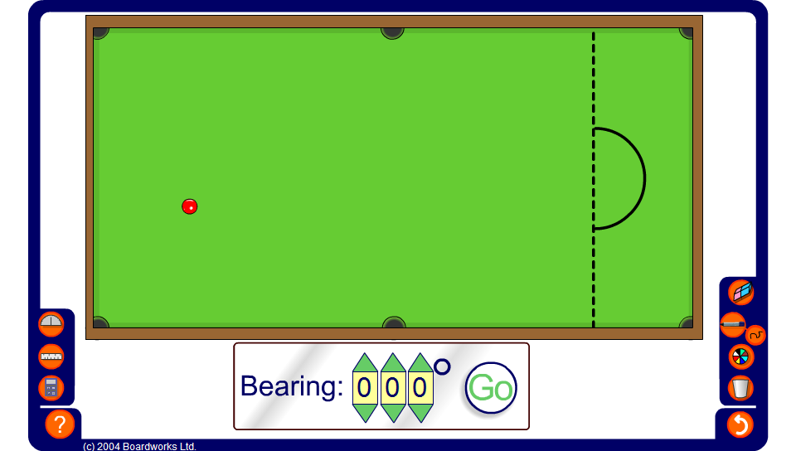


Virtual snooker
Notes:
Use this activity to estimate angles clockwise from north. These are written as three figure bearings.
Pupils need to discuss at what angle the ball must be hit to put it in a particular pocket. You may wish to decide this pocket, or you may wish to let pupils decide.
Challenge pupils to pot the ball in as few moves as possible. You can use the protractor once they’ve tried without!

